Slide 1
Understanding Data Types & Analysis

Slide 2
Understanding Data Types & Analysis
Title Slide
Introduction
Types of Data
Ordinal Data
Numerical Data
Binary Data
Summary of Data Types
Key Concepts in Data Analysis
Instance and Features
Example Dataset

Slide 3
Understanding Data Types & Analysis
Conclusion
Q&A Slide

Slide 4
Introduction
Significance of Data Understanding: Grasping data nuances influences analytical outcomes, fosters informed decisions, and enhances predictive accuracy.
Types of Data Matter: Different data types dictate analysis approaches; knowing them facilitates selecting appropriate methods effectively.
Foundation of Data Analysis: Strong data understanding forms the backbone of analytics, enabling deeper insights and meaningful interpretations.

Slide 5
Types of Data
Definition of Nominal Data: Nominal data represents categories without any intrinsic order, making it purely categorical in nature.
Characteristics of Nominal Data: Features include a lack of natural order, mutually exclusive categories, and no arithmetic operations possible.
Examples of Nominal Data: Common instances include gender classifications (Male, Female) and color designations (Red, Blue, Green).

Slide 6
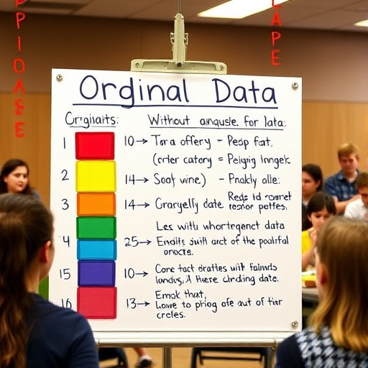
Ordinal Data
Definition of Ordinal Data: Ordinal data consists of categories with a meaningful order but inconsistent or non-uniform intervals.
Characteristics of Ordinal Data: Key traits include orderability in ranking and variability in differences between ranked values.
Examples of Ordinal Data: Typical examples are educational levels (High School < Bachelor’s < Master’s) and customer satisfaction rankings.
Generated on aidocmaker.com

Slide 7
Numerical Data
Definition of Numerical Data: Numerical data quantifies measurable quantities, encompassing both continuous and discrete subcategories with distinct characteristics.
Characteristics of Continuous Data: Continuous data spans any value within a range, allowing infinite divisions, crucial for precise measurements.
Examples of Discrete Data: Discrete data consists of countable values, such as integers, exemplified by the number of students in a class.

Slide 8
Binary Data
Definition of Binary Data: Binary data represents categorical information with only two distinct states or outcomes, often denoted as 0 and 1.
Characteristics of Binary Data: It includes mutually exclusive options, suitable for yes/no questions, and simplified categorical classifications.
Examples of Binary Data: Common examples include gender simplification (Male=0, Female=1) and light switch statuses (On=1, Off=0).

Slide 9
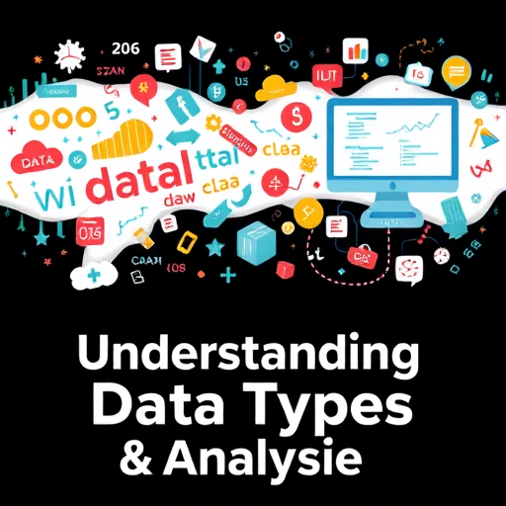
Summary of Data Types
Summary Table: A visual representation consolidating definitions and examples for each of the four main data types.
Nominal Data Characteristics: Includes categories without order; examples: gender, colors. Useful for categorical insights in analysis.
Ordinal Data Examples: Showcases ranked categories like satisfaction levels or education, illustrating meaningful order among them.
Generated on aidocmaker.com

Slide 10
Key Concepts in Data Analysis
Definition of Unit of Observation: The unit of observation is the entity or object being measured within a dataset’s structure.
Types of Units in Datasets: Units can represent individuals, groups, events, or objects, significantly influencing data interpretation quality.
Examples of Units: For instance, individual students in an education dataset or specific car accidents in traffic analysis.

Slide 11
Instance and Features
Definition of Instance: An instance signifies a single occurrence in the dataset, equating to one unique row representation.
Characteristics of Features: Features denote measurable attributes for instances, defining columns containing various data types and values.
Examples of Instances and Features: In a student dataset, an instance is a student, while features include name, age, and grade.

Slide 12
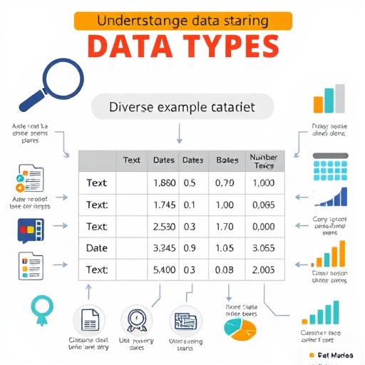
Example Dataset
Illustration of a Tabular Dataset: A simple student dataset demonstrates unit of observation, instances, and features clearly in analysis.
Identifying the Unit of Observation: The unit of observation here is students, delineating each row's representation in the dataset.
Defining Instances and Features: Instances are individual students per row; features encompass attributes like name, age, and grade.
Generated on aidocmaker.com

Slide 13
Conclusion
Recap of Data Types: Understanding data types enhances analysis strategies, ultimately driving more effective machine learning outcomes.
Significance in Machine Learning: Accurate data representation impacts model performance, influencing learning algorithms and their predictive capabilities.
Interconnectedness of Data Types: Different data types interact, shaping analytics approaches while informing feature selection in machine learning models.

Slide 14
Q&A Slide
Questions Welcome: Engage the audience inviting their inquiries for deeper understanding or clarification on presented topics.
Discussion Topics: Encourage conversations around practical applications and implications of data types in real-world scenarios.
Feedback Collection: Solicit audience feedback to enhance future presentations, fostering a collaborative learning environment.

